Slide 1
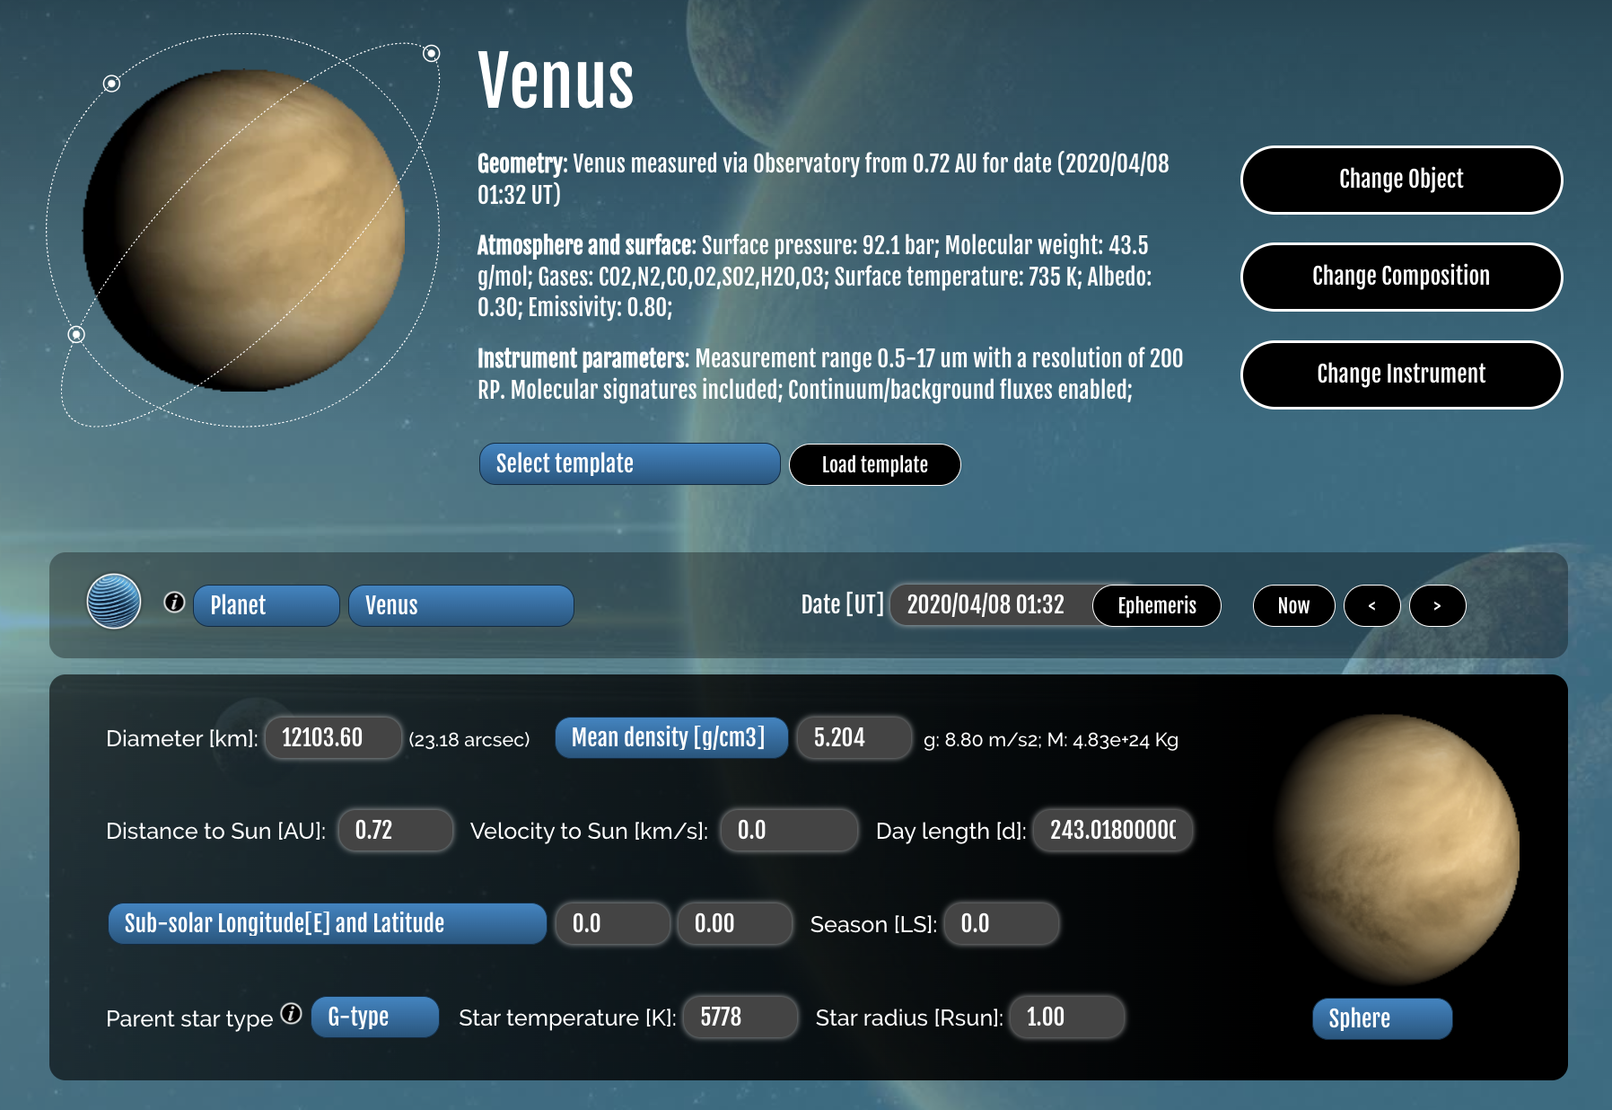

Modeling with the Planetary Spectrum Generator

Slide 2
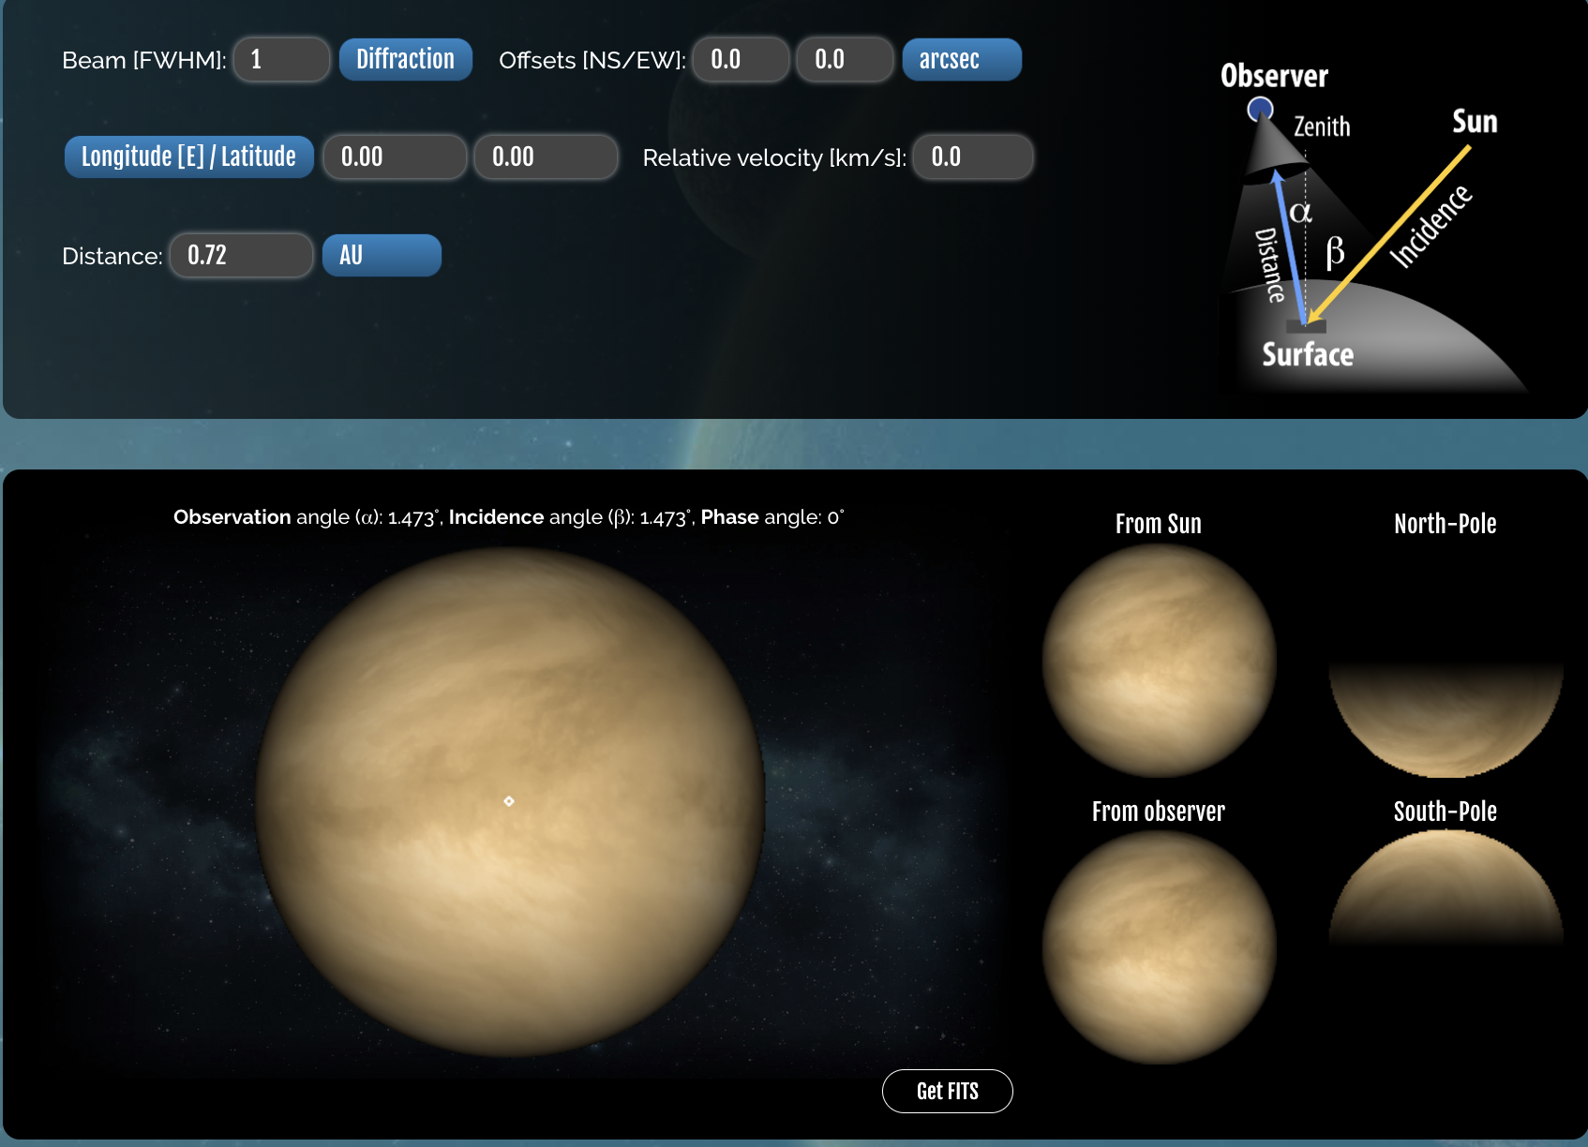
Modeling with the Planetary Spectrum Generator

Slide 3
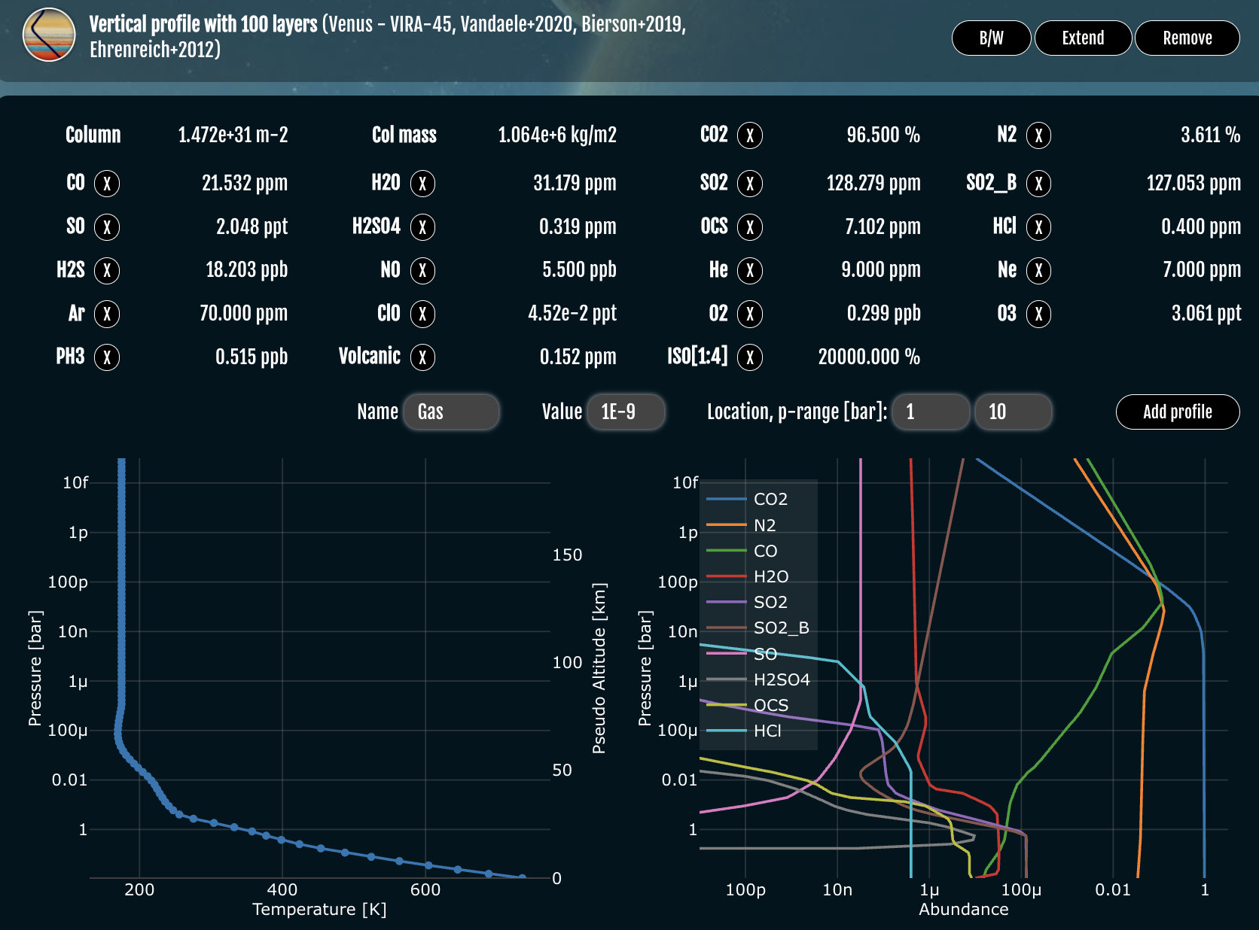
Modeling with the Planetary Spectrum Generator

Slide 4
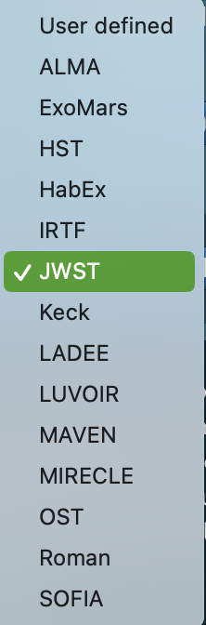
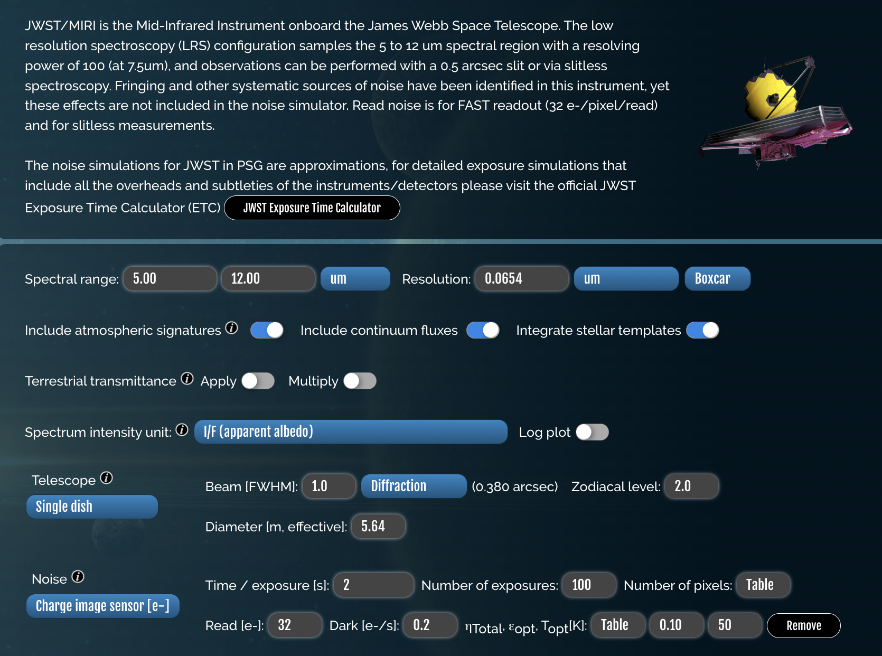
Modeling with the Planetary Spectrum Generator

Slide 5
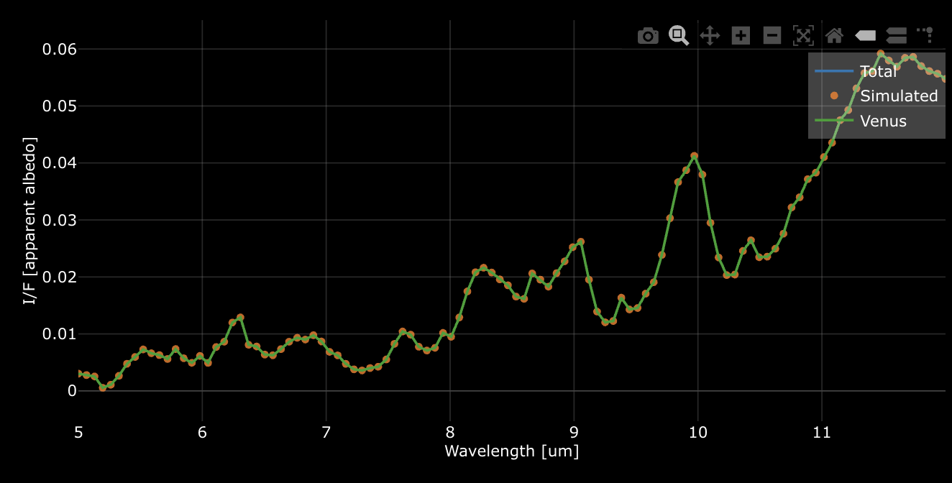
Modeling with the Planetary Spectrum Generator

Slide 6
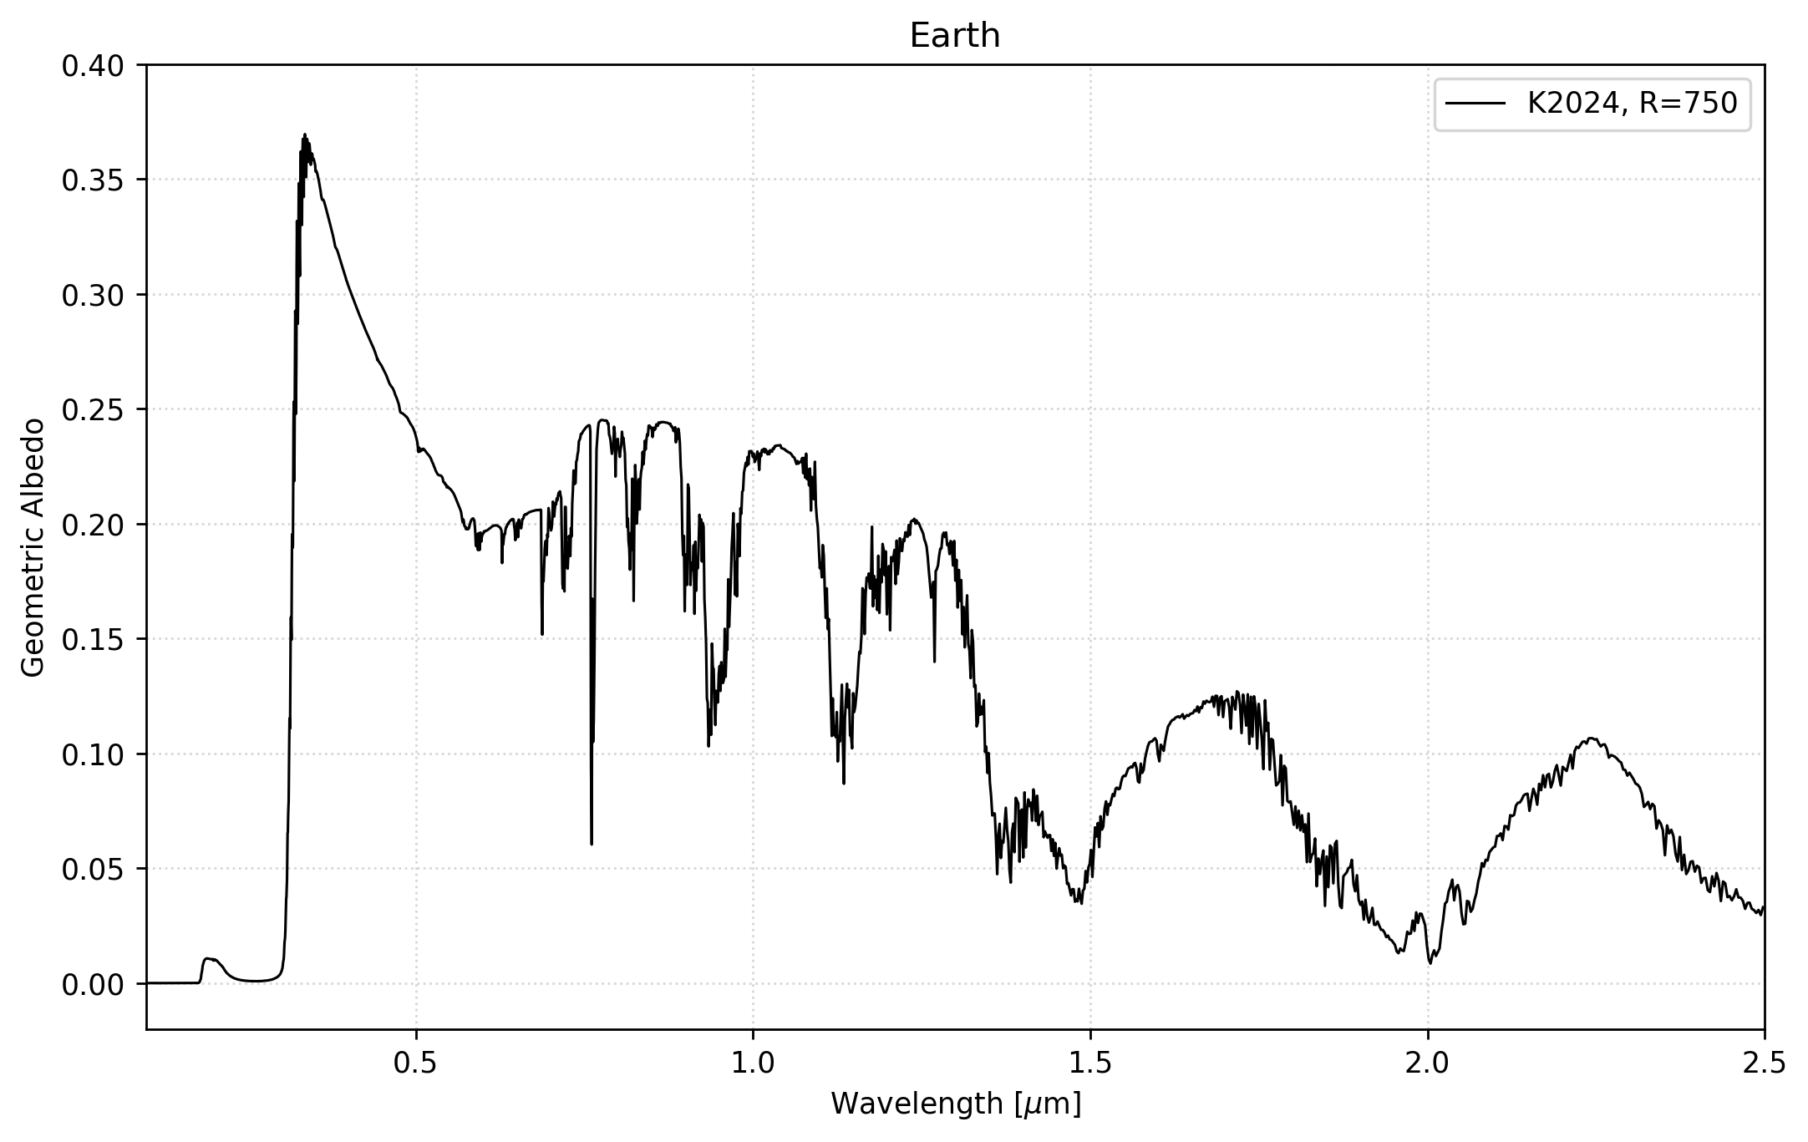
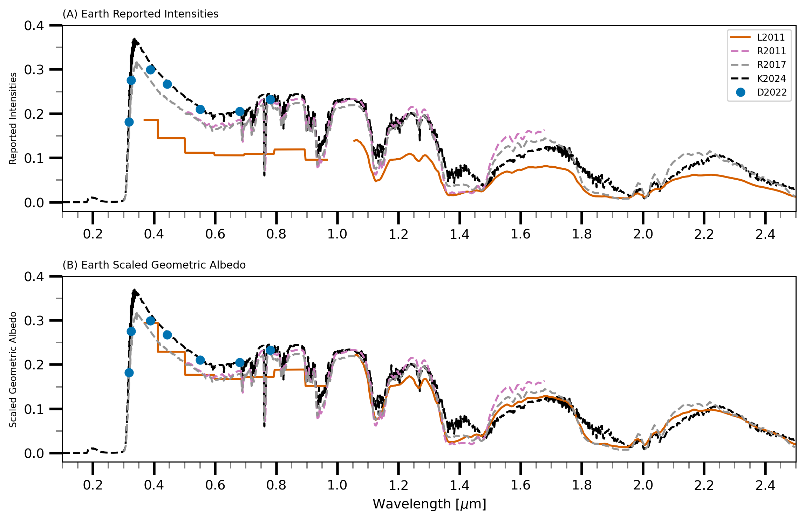
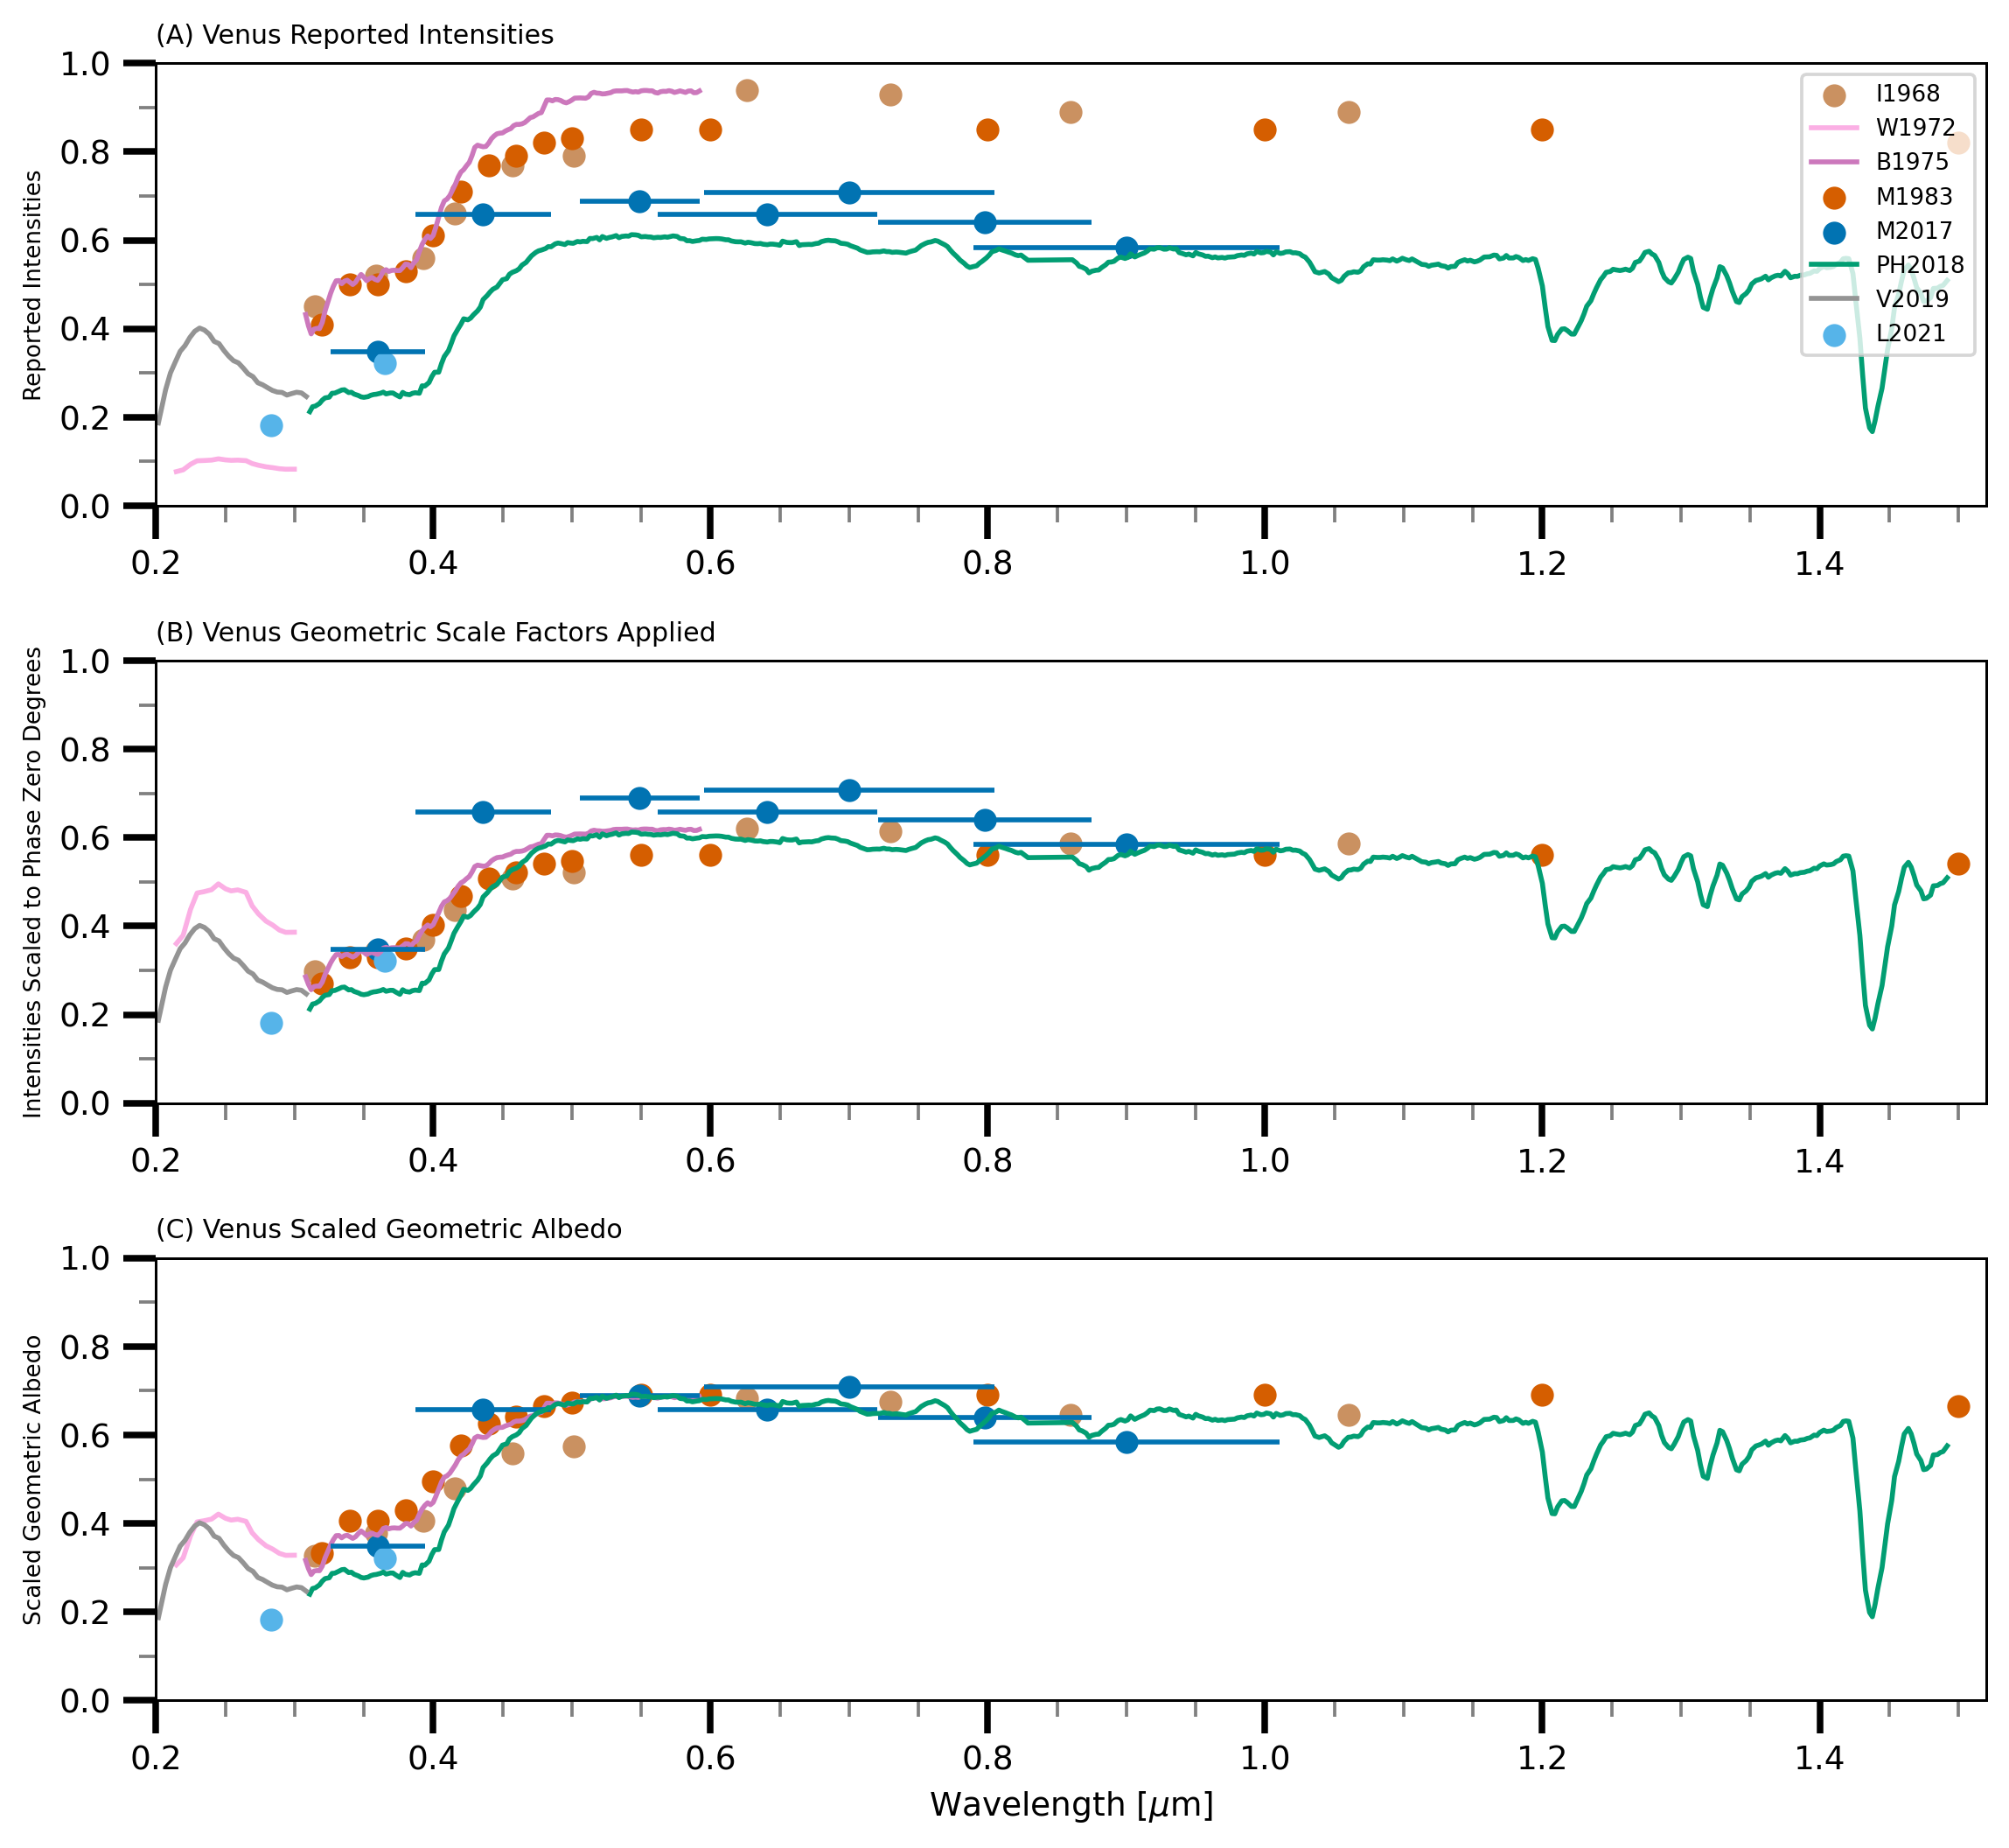
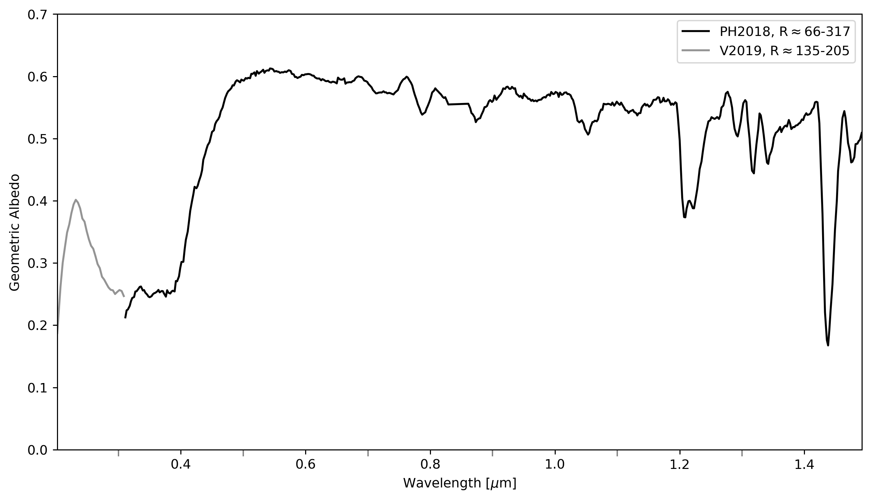
My Science Results
We must understand this spectrum to begin searching for life in the universe!

Slide 7
NASA Science Today - Highlights
Artemis/ Mars
Artemis II (scheduled for April 2026): First crewed test flight around the Moon.
Artemis III (planned for mid 2027): Planned lunar landing later this decade
Nancy Grace Roman Space Telescope – launch planned for May 2027
JWST and HST
Habitable Worlds Observatory

Slide 8
NASA Science – 5 divisions
Planetary Science - Understanding the origin, evolution, and structure of the solar system and planetary systems around other stars. (Largest budget – more expensive missions)
How did the solar system form?
Are there other habitable worlds?
2. Earth Science - Studying Earth's systems (atmosphere, oceans, land, ice) to understand climate change, natural hazards, and global dynamics. (Largest division – Employing the most scientists)
How is Earth changing and why?
How will Earth’s systems respond to changes?

Slide 9
NASA Science – 5 divisions
3. Astrophysics - Exploring the universe beyond the solar system—galaxies, black holes, stars, exoplanets, and the Big Bang.
What is the origin and fate of the universe? (JWST, HST)
What is the nature of dark matter and dark energy? (JWST, HST)
4. Heliophysics- Studying the Sun, solar wind, magnetic fields, and their effects on the solar system and Earth’s space environment..
What drives space weather/ solar winds?
How does the Sun affect Earth and other planets? (Northern lights/ solar radiation, impacts on technology, habitability)
5. Biological and Physical Sciences (BPS)- Investigating how spaceflight and microgravity affect biological and physical systems—critical for human exploration.
How do humans and life adapt to space?
How can we enable human spaceflight?

Slide 10
2024 – Best of NASA
https://www.youtube.com/watch?v=pvjzva-q58Y

